Slide 1
Lecture Four Other Expendable Mold Processes
Shell Molding
Vacuum Molding
Expanded Polystyrene Process
Investment Casting
Plaster Mold and Ceramic Mold Casting

Slide 2
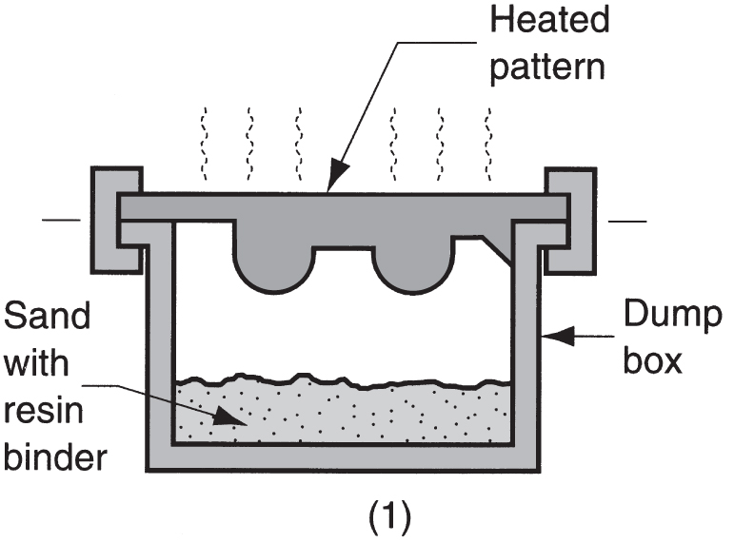
Shell Molding
Casting process in which the mold is a thin shell of sand held together by thermosetting resin
Steps: (1) A metal pattern is heated and placed over a box containing sand mixed with TS resin

Slide 3
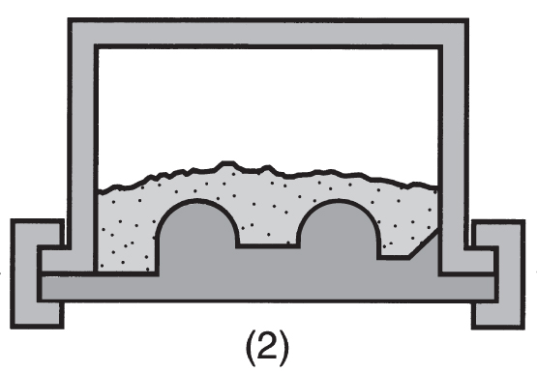
Steps in Shell Molding
(2) Box is inverted so that sand and resin fall onto the hot pattern, causing a layer of the mixture to partially cure on the surface to form a hard shell

Slide 4
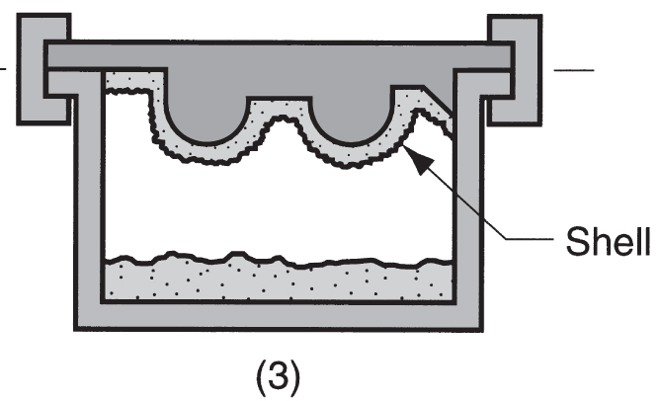
Steps in Shell Molding
(3) Box is repositioned so loose uncured particles drop away

Slide 5
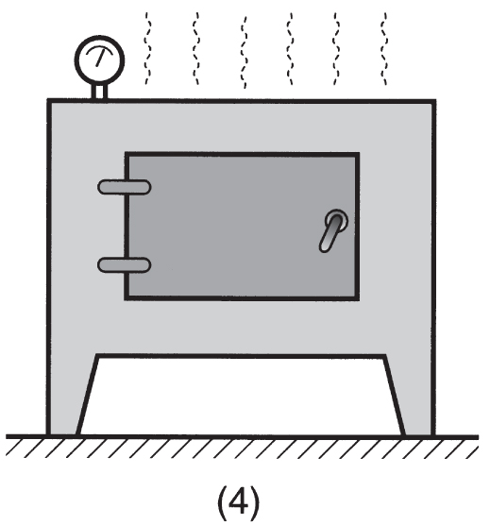
Steps in Shell Molding
(4) Sand shell is heated in oven for several minutes to complete curing

Slide 6
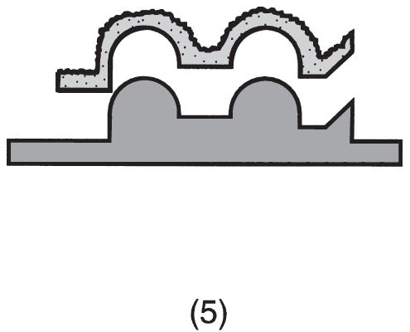
Steps in Shell Molding
(5) shell mold is stripped from pattern

Slide 7
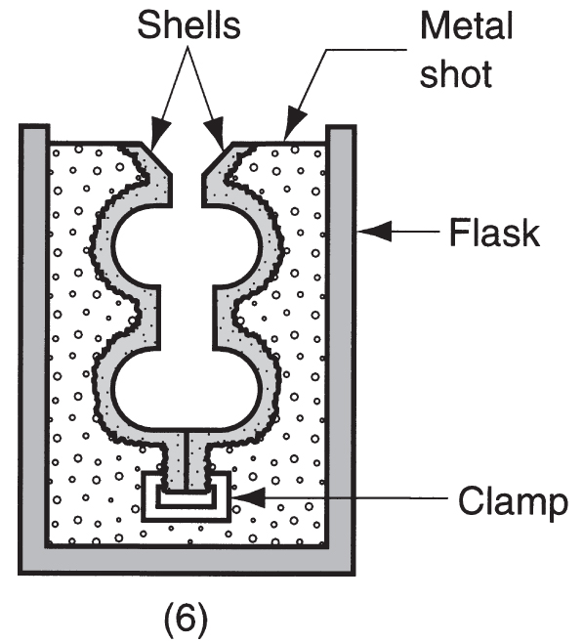
Steps in Shell Molding
(6) Two halves of the shell mold are assembled, supported by sand or metal shot in a box, and pouring is accomplished

Slide 8
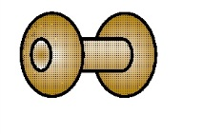
Steps in Shell Molding
(7) Finished casting with sprue removed

Slide 9
Shell Molding: Advantages and Disadvantages
Advantages:
Smoother cavity surface permits easier flow of molten metal and better surface finish
Good dimensional accuracy
Mold collapsibility minimizes cracks in casting
Can be mechanized for mass production
Disadvantages:
More expensive metal pattern
Difficult to justify for small quantities

